Slide 1
Live Variable Analysis
EECE 5183
Marshal Stewart
CE Undergrad

Slide 2
Goals
Define Liveliness
Utilize Liveliness to optimize our programs
Discuss optimization methods that utilize liveliness

Slide 3
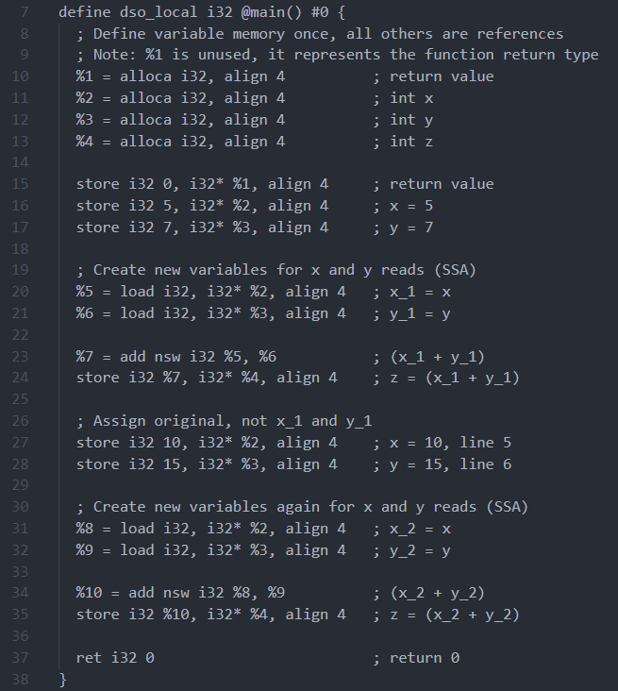
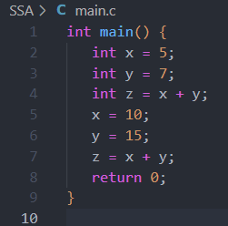

Static Single-Assignment Form (SSA)
Property of an intermediate representation (IR) that requires each variable to be assigned exactly once and defined before it is used. (LLVM)
Each variable is independent, no side effects on other code sections

Slide 4
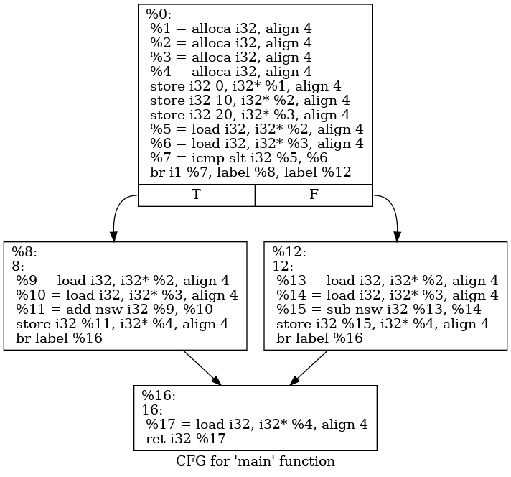
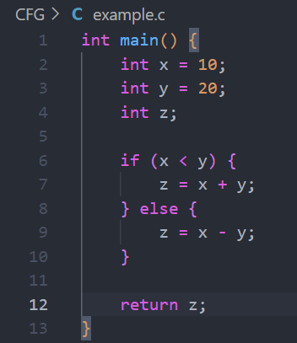
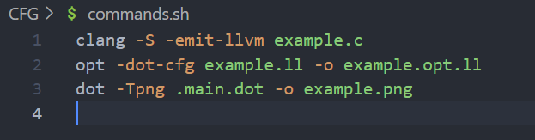
Control Flow Graphs
%1 => z
%2 => x
%3 => y
%4 => return value
%5 => x_1 in cond on line 6
%6 => y_1 in cond on line 6
%7 => (x_1 < y_1) output
%8 => stores label for (x<y)
%9 => stores x_2 on line 7
%10 => stores y_2 on line 7
%11 => z_1, line 7
%12 => stores label for (else)
%13 => stores x_3, line 9
%14 => stores y_3, line 9
%15 => stores z_2, line 9
%16 => stores label, after cond
%17 => stores return value
Representation of sets of statements in a graph form, such that an edge is a branch of execution taken, a node is a set of instructions. The last instruction in a set before an edge usually being a condition check.

Slide 5
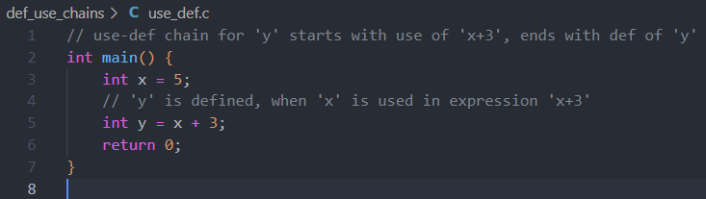
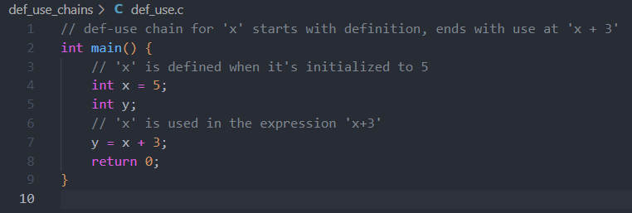
Def-Use and Use-Def Chains
Represents the flow of information from the definition of the variable itself to its use.
Variable Dependencies
Def -> Write, Use -> Read

Slide 6
Liveliness Algorithm Terms
Liveliness Analysis
Group of techniques used for optimization, by determining life-times of variables
Live Variable
A variable that at any given instant of time, is begin used to process a computation through evaluation, or hold a value that will be used in the future without re-definition
Live Range
Defines continuous and/or discrete portions of code for which a variable is live. (Variables can move between the live and dead state
Live
A variable ‘v’ is live on edge ‘e’ if there exists a directed path from the edge ‘e’ to use of ‘v’ that does not pass through any def(v)
Live-In
A variable ‘v’ is live-in at node ‘n’ if the variable is live on any n’s in-edges
Live-Out
A variable ‘v’ is live-out at a node ‘n’ if live on any of n’s out-edges

Slide 7
Liveliness Algorithm
Evaluates the liveliness of each variable at each step. Analyzes the live ranges with the goal of sharing common registers that don’t overlap liveliness.
Step 1 (Executed only once)
Identify defined variables, and which are used in each basic block. (def-use chains)
Initialize IN and OUT to null
Step 2
Maintain global information records (transmission of live values). Compute IN and OUT sets from def and use sets by using the expression (utilize def-use chains)
Step 3
Iterate step 2, until IN and OUT sets become constant for successive iterations. Def and use sets are constants, therefore path independent.

Slide 8
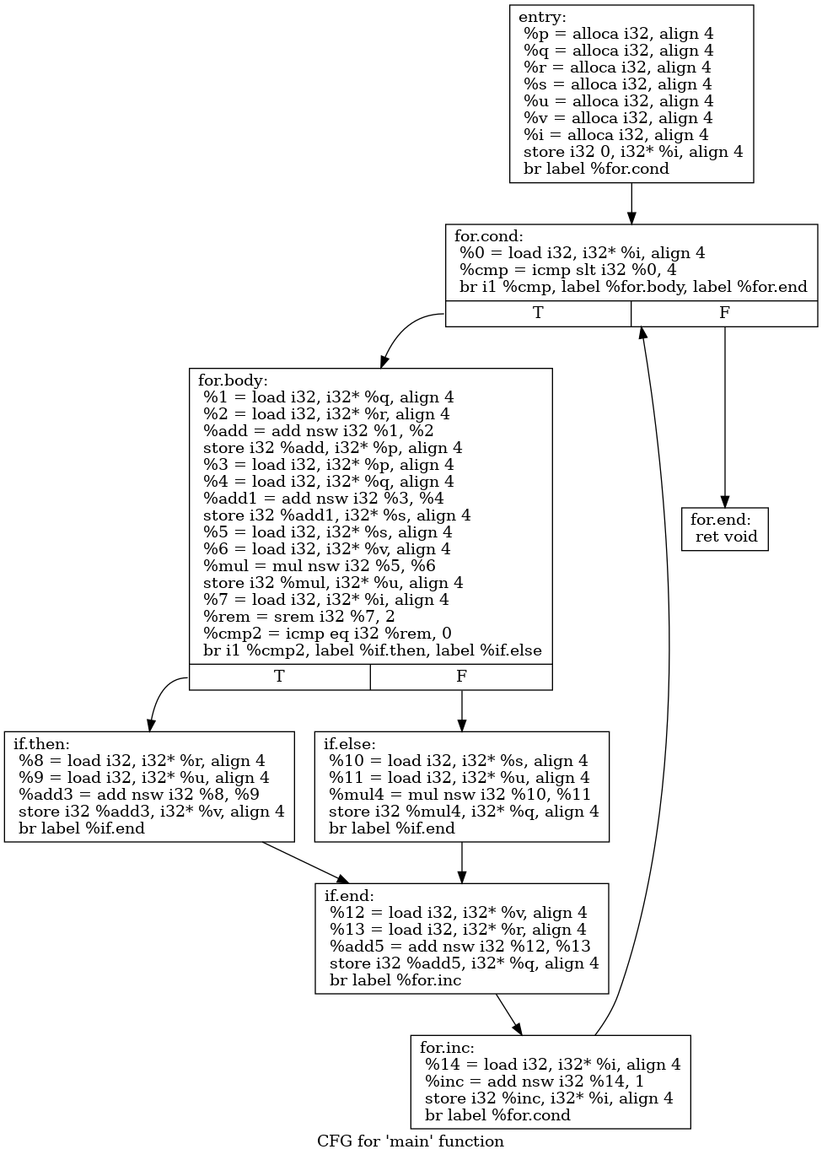
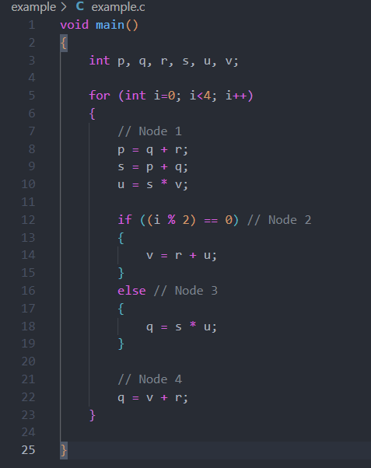
Step 1

Slide 9
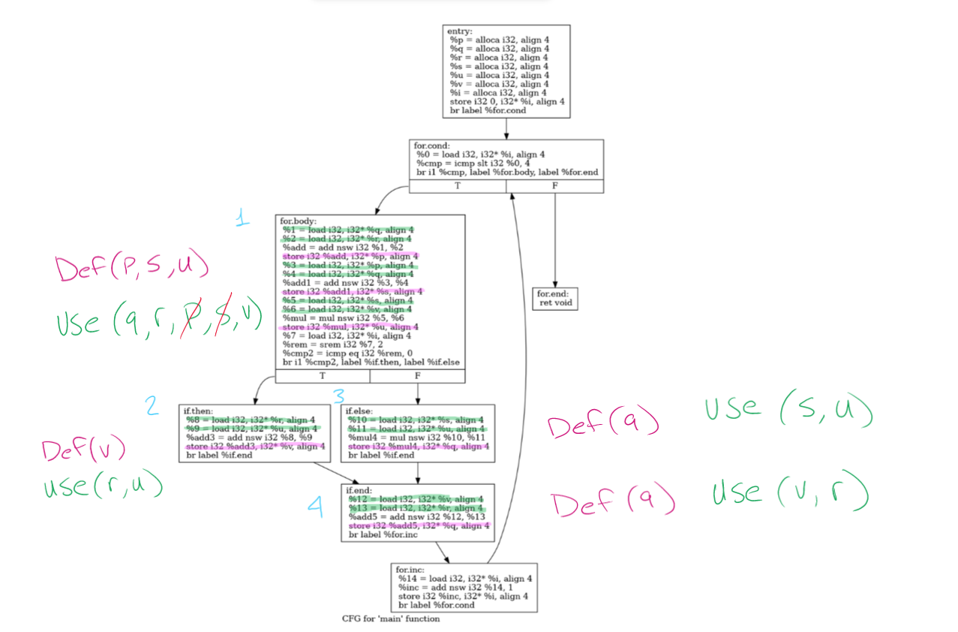
Step 1

Slide 10
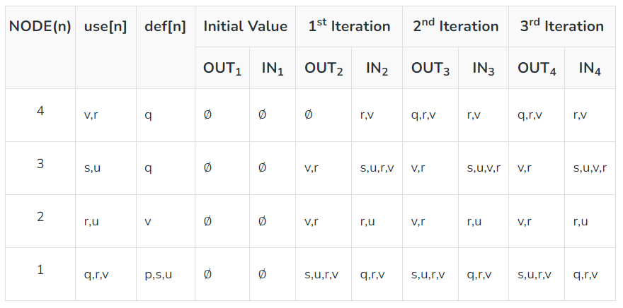
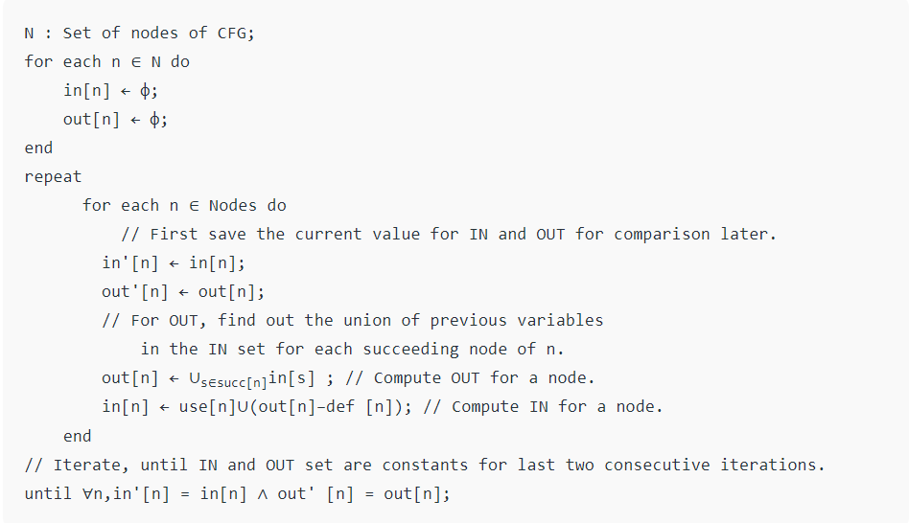
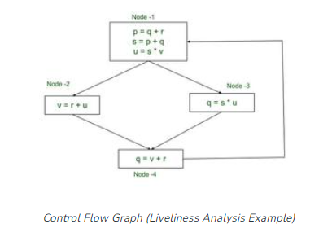
Example + Proof

Slide 11
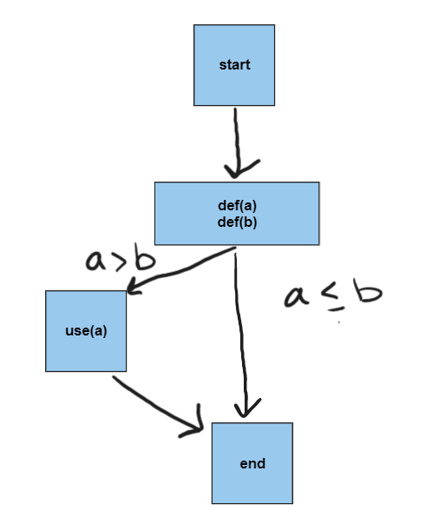
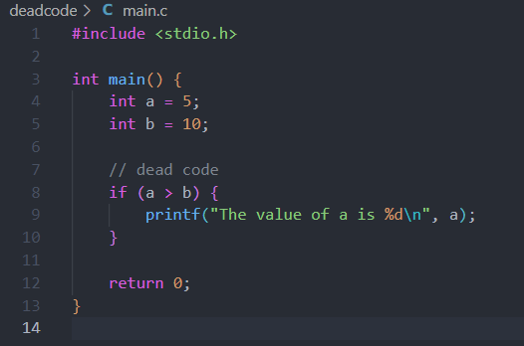
Dead Code elimination
Removing code that has no effect on the program's output or behavior.

Slide 12
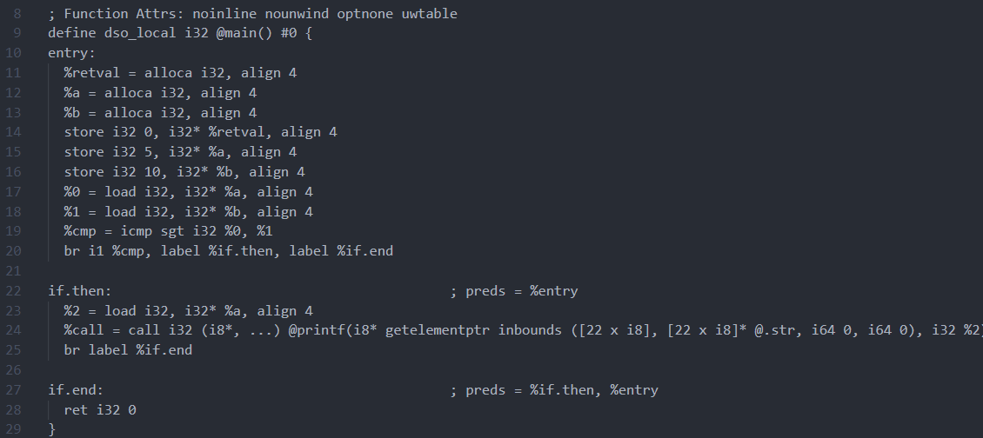
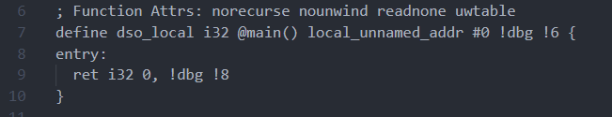





Slide 13
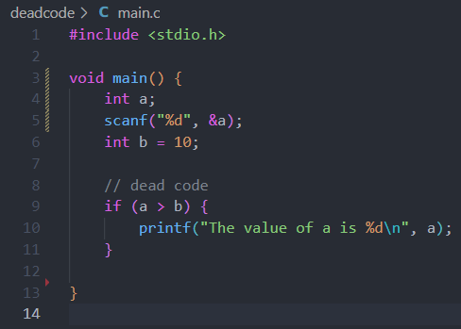
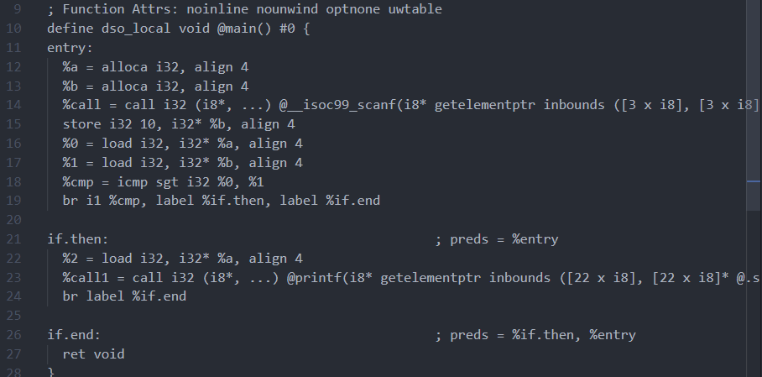
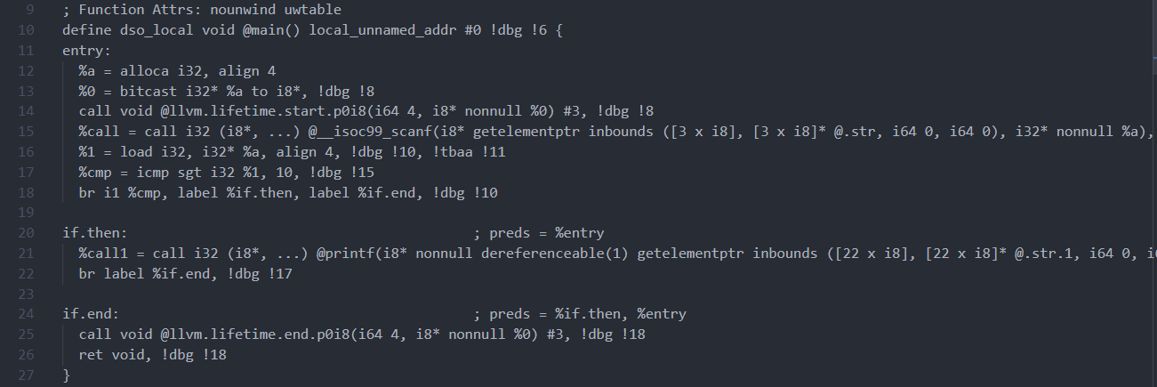





Slide 14
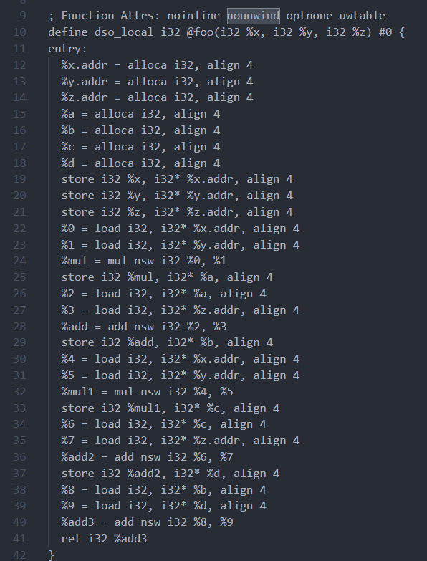
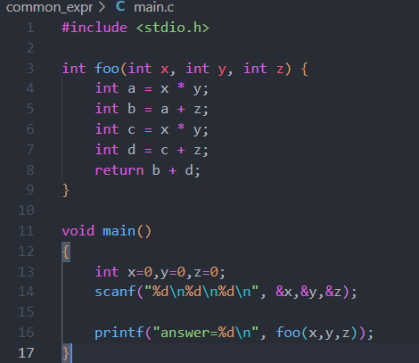
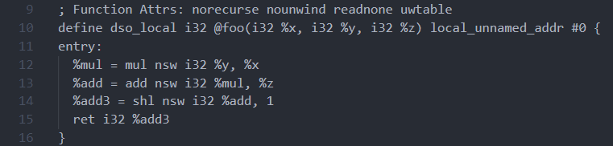
Common Subexpression Elimination
Identifying expressions that are repeated and storing the result in a temporary variable

Slide 15
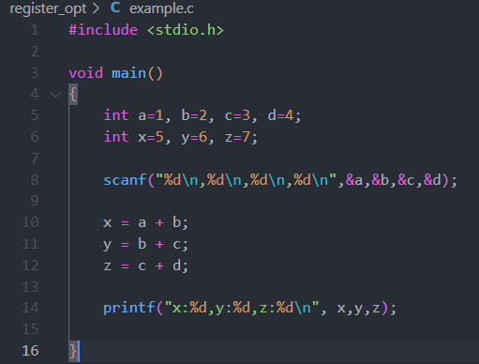
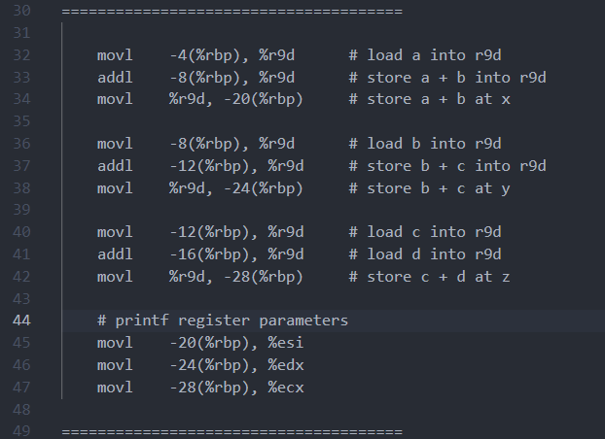
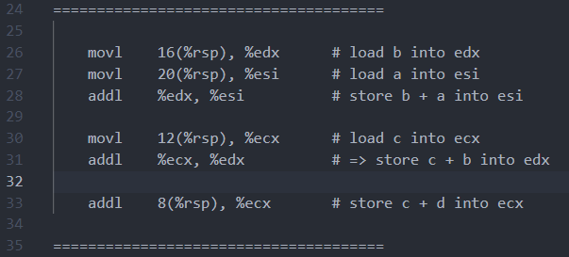
Register Allocation Optimization
Allocating registers to hold intermediate results,
Reduce the number of memory accesses
Minimizing the amount of data that needs to be loaded and stored in memory.
Unoptimized: 13 instructions, use of r9d prevents potential for pipelining
Wrote to registers, back to memory, back to register for printf
Optimized: 6 instructions

Slide 16
Loop Optimization
Loop Unrolling
Executing multiple loop iterations for a single iterator value
Loop-Invariant Code Motion
Moves computations that are not dependent on the loop iteration outside the loop
Loop Fusion
Combining two or more loops that have similar dependencies, access patterns, and bounds into a single loop

Slide 17
References
Github: MarshalStewart, Repo: EECE5183_presentation
https://github.com/MarshalStewart/EECE5183_presentation
GeeksForGeeks
X86_instruction_listings
https://clang.llvm.org/docs/
https://llvm.org/docs/LangRef.html

